Slide 1
West Nile Ballers
Friday, August 10th 2017

Slide 2
Agenda
Overview | 3
Approach | 4
Model Specification | 6
Findings | 7
Recommendations | 10

Slide 3
Overview
Our team modeled the presence of West Nile to understand where it might develop next.
THE CHALLENGE
Predict where the City of Chicago should spray to prevent West Nile Outbreaks through an efficient and cost-effective approach
THE APPROACH
EXPLORATION
Conduct basic analysis to visualize trends, find missing information, and understand the nature of the dataset
DATA CLEANING
Reformat data, complete/drop missing data, and structure data in preparation for further analysis.
FEATURE ENGINEERING
Generate new features based on existing columns to reframe our understanding and aid our analysis
MODELING
Create models of the data to predict outcomes and evaluate model performance to incrementally improve predictions
ANALYSIS
Review the outputs of models and apply models to predict results
INTERPRETATION
Interpret the results of model predictions to make determinations and recommendations

Slide 4
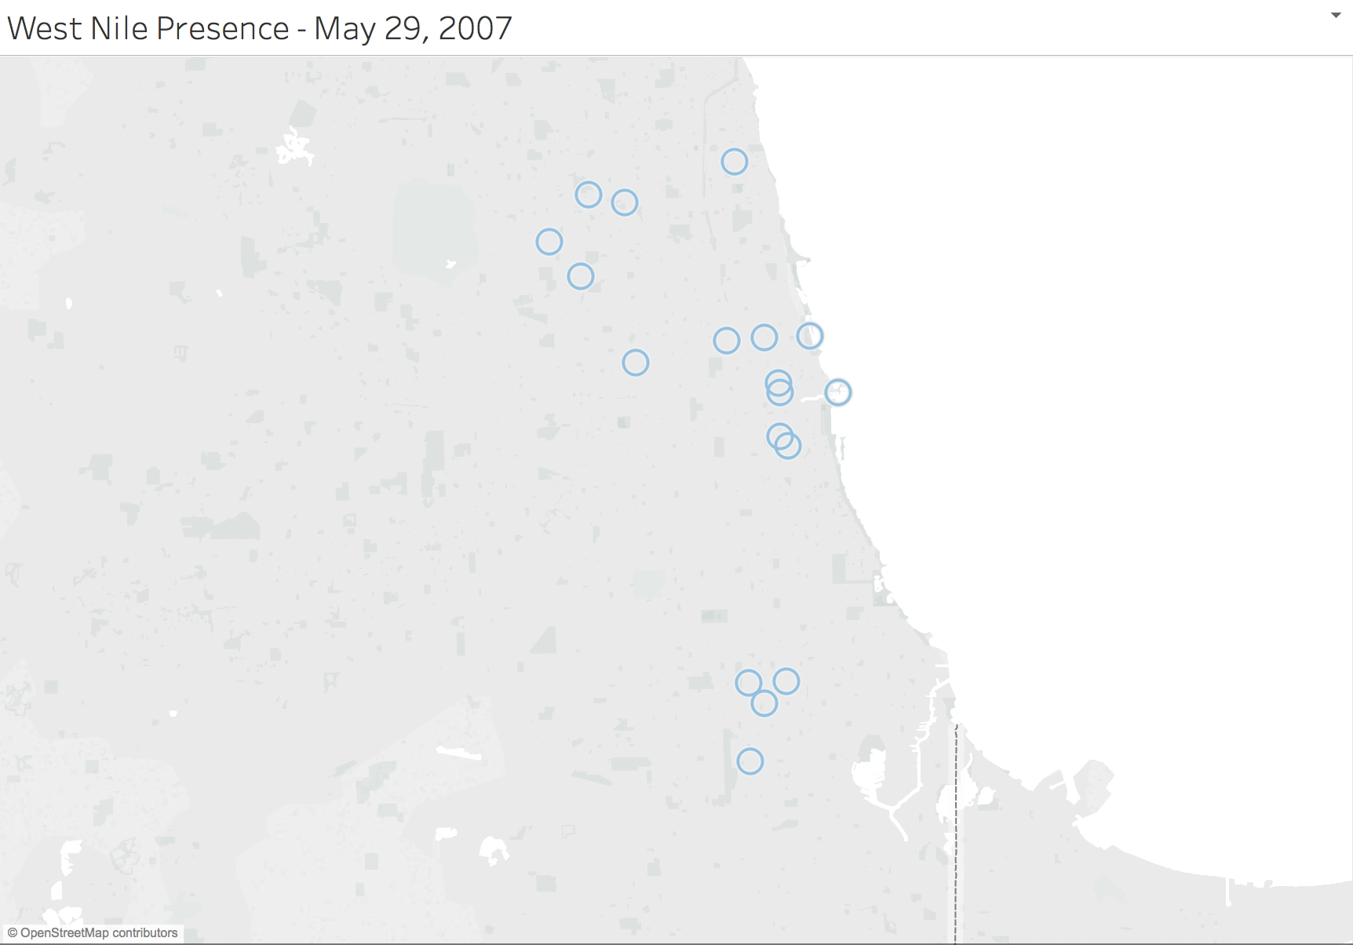
Exploration
We uncovered some high level trends to help inform our approach and analysis
Data
West Nile Testing for 2007, 2009, 2011, 2013
Species
WNV status
Trap and Location
Date
Spray day for 2011 and 2013
Weather data for 2007 – 2014
Temperature
Rainfall
Daylight
All Traps for 2007, 2009, 2011, 2013
Weather is Important
Previous temperatures
Previous rainfalls
Daylight hours
Temperature above average
All Traps for 2007, 2009, 2011, 2013

Slide 5
Assumptions and Initial Steps
Based on our exploratory analysis, we made a few assumptions and Features
ASSUMPTIONS
FEATURES
We used a training dataset for 2007, 2009, 2011, 2013 and a test dataset for 2008, 2010, 2012 and 2014
95% of observed mosquitos test negative for West Nile, so we need to evaluate our models differently – AUC score
Spray data should not factor into our predictions
We limited our analysis to only features that are available for both the training and test data
Weather
7, 14, and 30 day past averages/totals for
Temperature
Rainfall
Departure from average temperature
Daylight Hours
Dew Point/Humidity
Windspeed
Training Data
Species factorization
Prior large mosquito populations
Trap factorization

Slide 6
Model Specification
Our team tested multiple models to inform our approach
Gridsearched parameters
Included all available features
Selected features by importance
71%
RANDOM FOREST
Used all features to try understand feature importance
Looked at odds ratios
N/A
LOGISTIC REGRESSION
Used important features from random forest/logistic regression
Used generated features
Tuned parameters
75%
XGBOOST

Slide 7
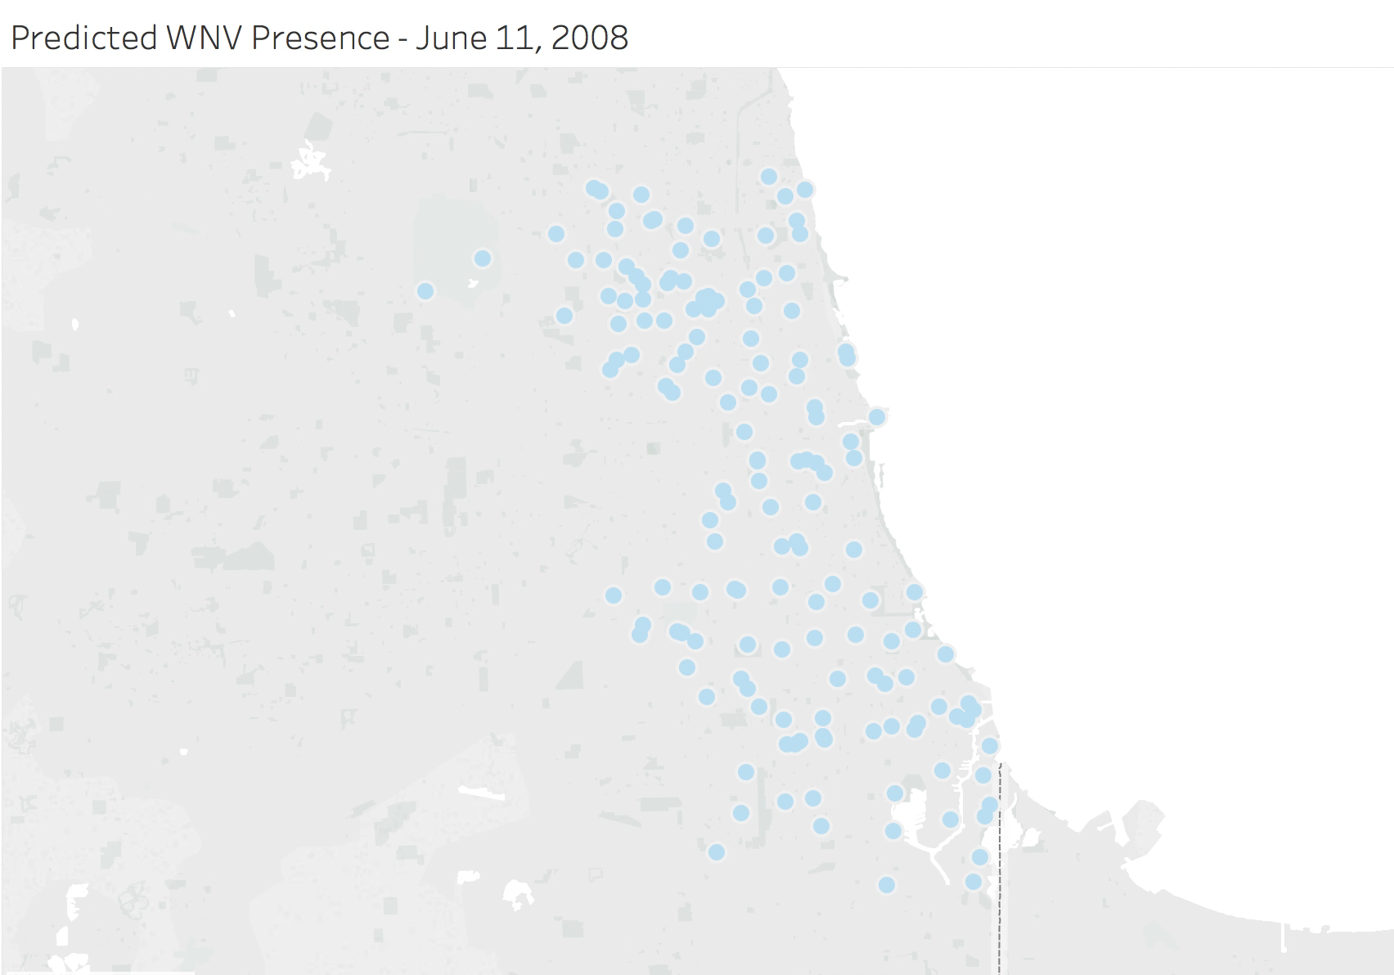
Findings
Based on the performance of our model, our team identified locations susceptible to WNV
Highest Likelihood WNV Locations
Locations in the Northwest of Chicago
Southern Chicago
Factors influencing likelihood of WNV
Hotter months
Later in the summer
Higher presence of the Culex Pipiens and Culex Restuans

Slide 8
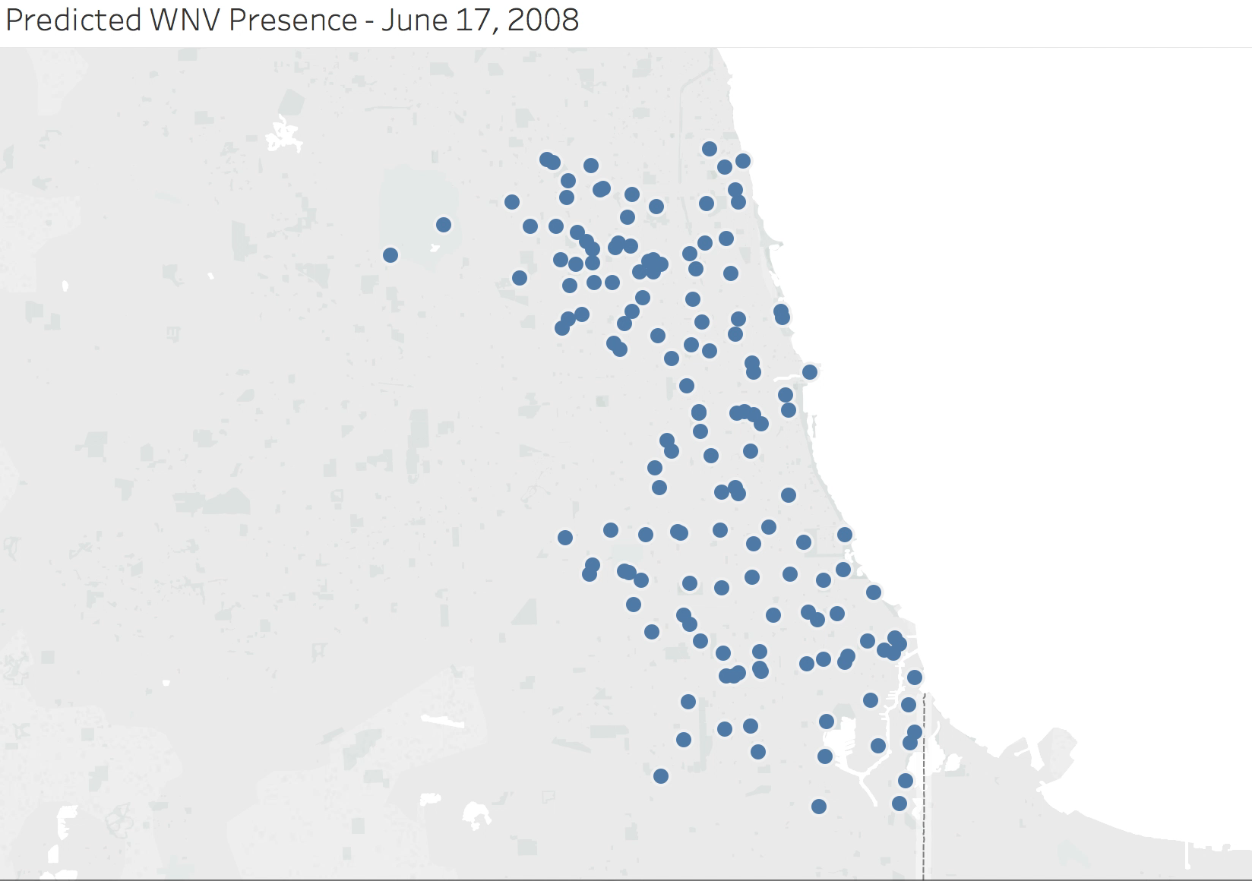
What does it mean?
Although locations may show West Nile, it might not be likely to break out

Slide 9
Deciding When to Spray
WNV Infection Rate of mosquitoes can be used to inform decisions to spray
Integrated Pest `Management
Prevention
Public information
Personal protection methods (avoidance, repellants, clothing)
Source reduction of mosquito breeding sites
Control of mosquito larvae
Environmental Surveillance
Collect data (traps, field surveys, WNV positive birds, human cases)
Provide indicators of the threat to humans and identify geographic areas of high risk
Support decision for intervention
Monitor effectiveness
Based on 2013 data, Minimum Infection Rate is approximately 0.25:
# of WNV Positive Pools/Total # of Mosquitoes tested

Slide 10
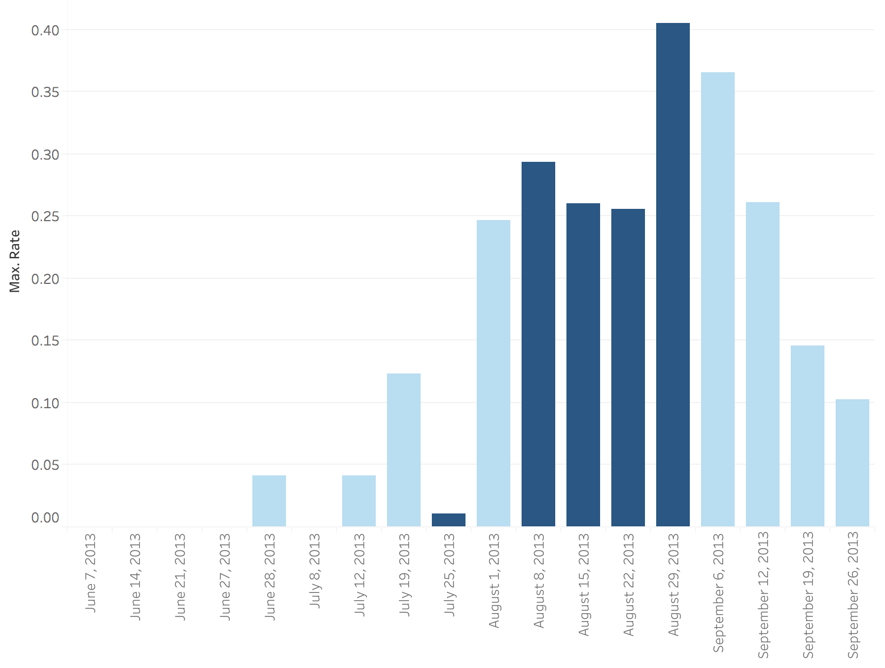
2013 Minimum Infection Rate of WNV

Slide 11
Costs and Benefits
Choosing locations to spray depends on the costs and benefits
Cost Breakdown
Spray Costs
>= $60 per Linear Mile
Estimate to spray all of Chicago (227.34 Sq Miles) - $818,424
2013 spray costs estimated at $520,051
Hospitalization Costs
Median cost Hospitalized for Meningitis or Fever - $7,500
Median cost Hospitalized for Acute Flaccid Paralysis- $25,000
Median Work Days Missed by Hospitalized Patient – 42
2013 Medical and Hospitalization- $575,000 to $1.5 Million
60 reported Cases, 7 Deaths associated with WNV
Benefits Breakdown
WNV Outbreak After 14 Days, 0 New Human Cases.
Less Expensive to Spray vs Possible Medical Costs
Risk of illness from West Nile virus is greater than the small risk associated with adulticiding.

Slide 12
Recommendations
Based on our analysis, we recommend spraying in these areas
RATIONALE
West Nile seems likely to become more prevalent later in the summer
Spraying should take place about 14 days and 30 days in advance of predicted WNV probability
An infection rate of mosquitos above ~25% indicates a likelihood that spraying should take place
Above average temperatures can lead to higher probability of WNV, 14 days and 30 days in advance
NEXT STEPS
Include data on Human Infection rates to understand how WNV presence increases the likelihood of infections in humans
Include more robust weather forecasting metrics to help predict WNV

Slide 13
Questions

Slide 14
Appendix

